Slide 1
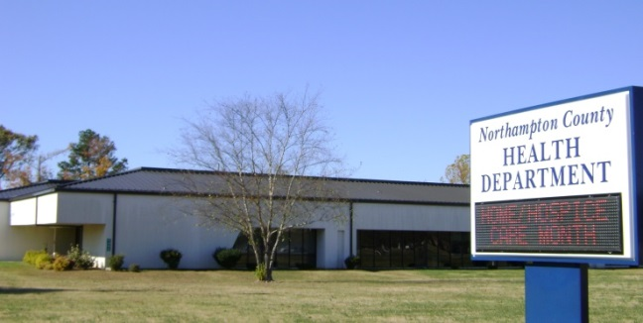
2017-2018 Statistical Report
MISSION: Promote, provide and protect the health and safety of the citizens of Northampton County.
Board of Health Handbook
Public Health Works

Slide 2
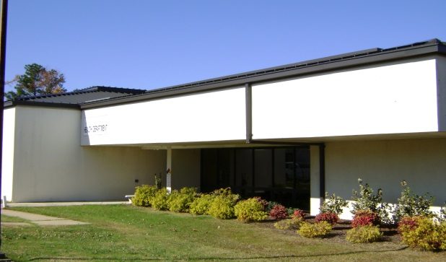
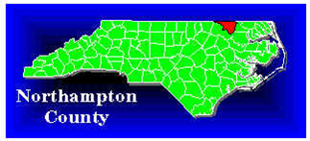
2017-2018 Statistical Report
Mission:
Promote, provide and protect the health and safety of the citizens of Northampton County.
Vision:
A culturally sensitive health organization providing quality services yielding improved health outcomes.

Slide 3
Management
2017-2018 Statistical Report
The Northampton County Board of Health and the staff of the Northampton County Health Department are pleased to present our annual report for fiscal year 2017 – 2018.
Andy Smith, Health Director
Management Team as of June 30, 2018
Cheryl Warren Administrative Officer
Judi Northcott
Clinical Nursing Supervisor
Blair Creekmore, NFP Supervisor
Sheila Person, WIC Director
Tina Edwards
Lab Manager
Susan Finney
Home Health Nursing Supervisor
Megan Vick
Human Services Planner/Evaluator
John White, Environmental Health Supervisor
LEADERSHIP- Andy Smith Health Director
Carol Lee
Social Worker
Management Team meets on the 4th Tuesday at 9:00 am in the Health Department Conference Room.

Slide 4
2017-2018 Statistical Report
Goals:
2017-2018 Strategic Goals
Strategic Goals
The following goals were identified in the Healthy Carolinians action plans in response to the Northampton County Health Department’s Community Health Assessment.
Goal 1 | Increase the number of smoke-free or smoke free/e-cigarette free policies.
Goal 2 | Increase the number of organizations that provide education intervention that address cancer risk factor..
Goal 3 | Develop and maintain a qualified public health workforce.
Goal 4 | Improve the following Home Health Process Quality Measure: Improvement in pain interfering with activity.
Goal 5 | Improve and enhance the Animal Control and Environmental Health programs.
Goal 6 | Continue to improve Case Management
Goal 7 | Improve and enhance clerical efficiency.
Goal 8 | Maintain lab certifications.
Goal 9 | Continue to improve and enhance the Nurse Family Partnership program.
Goal 10 | Continue to improve Clinical Services.
Goal 11 | Improve the Preparedness of the Health Department and County.
Goal 12 | Increase WIC caseload through outreach.
Goal 13 | Improve and enhance the Administrative services of the Health Department.

Slide 5
2017-2018 Statistical Report
GOVERNING BODY
Dentist Representative
Pharmacist Representative
Commissioner Representative
The Board of Health consists of 11 members. Membership is mandated by the North Carolina General Statutes to include a registered nurse, a dentist, a veterinarian, an optometrist, a physician, a pharmacist, an engineer, a member of the County Board of Commissioners, and three members of the community at large. Each member can serve up to three consecutive three-year calendar terms.
Board of Health
Dr. Thomas Vinson
Rev. Charles Tyner
Dr. Raven Deloatch
Mr. Scott Emory
Ms. Ruth Moody
Mr. Ben Moses Vice Chairman
Mrs. Johnnie Rawles
Ms. Marian Mizell
Vacant
Dr. William R. Futrell, Jr. Chairman
Dr. Hannah Parker
Registered Nurse Representative
Represents Municipalities
Public Member representing Education
The Board of Health meets the 2nd Tuesday of every month at 7:00 PM in the Health Department Conference Room.
Physician Representative
Positions as of June 30, 2018.
Veterinarian Representative
Professional Engineering Representative
Public Member representing Agriculture
Public Member representing Education

Slide 6
2017-2018 Statistical Report
Calendar Year 2018 Board of Health Meeting Dates:
MONTH | DATE | YEAR
January | 9 | 2018
February | 13 | 2018
March | 13 | 2018
April | 10 | 2018
May | 8 | 2018
June | 12 | 2018
July | 10 | 2018
August | 14 | 2018
September | 11 | 2018
October | 9 | 2018
November | 13 | 2018
December | N/A | 2018
Board of Health Meetings are held in the Health Department Conference Room on the second Tuesday of every month at 7:00 PM.

Slide 7
Board of Health Operating Procedures
2017-2018 Statistical Report
Name and Office.
The name of this organization is the Northampton County Board of Health (hereinafter “Board”). The principal office of the Board is located at 9495 N.C. 305 Highway, Jackson, N.C., 27845.
Officers and Committees.
Chair and Vice-Chair
The Board members shall elect a Chair and Vice-Chair by majority vote each year at the January meeting.
Secretary
The local health director shall serve as Secretary to the Board, but the director is not a member of the Board. The local health director may delegate the duties of the Secretary that are set forth in these operating procedures to an appropriate local health department employee.
Standing committees
The Board shall have the following standing committees:
Accreditation
All standing committees are subject to the North Carolina open meetings laws and shall comply with the provisions of those laws.
Meetings.
Regular Meetings.
The Board shall hold a regular meeting on the second Thursday of the month. The meeting shall be held in the Health Department Conference Room, J. W. Faison Administrative Building, Jackson, N.C. and shall begin at 7:30 PM.
Minutes.
The Secretary shall prepare minutes of each Board meeting. Copies of the minutes shall be made available to each Board member before the next regular Board meeting. At each regular meeting, the Board shall review the minutes of the previous regular meeting as well as any special or emergency meetings that have occurred since the previous regular meeting, make any necessary revisions, and approve the minutes as originally drafted or as revised. The public may obtain copies of Board meeting minutes at the Northampton County Health Department.
Amendments to Operating Procedures.
These operating procedures may be amended at any regular meeting or at any properly called special meeting that includes amendment of the operating procedures as one of the stated purposes of the meeting. A quorum must be present at the meeting at which amendments are discussed and approved, and any amendments must be approved by a majority of the members present at the meeting.
Other Procedural Matters.
The Board shall refer to the current edition of Robert’s Rules of Order Newly Revised (RONR) to answer procedural questions not addressed in this document, so long as the procedures prescribed in RONR do not conflict with North Carolina law.
Compliance with North Carolina Law.
In conducting its business, the Board shall comply with all applicable North Carolina laws, including but not limited to open meetings laws, public records laws, and the laws setting forth the powers and duties of local boards of health. To assist the Board in compliance, the local health director shall maintain a current copy of relevant North Carolina General Statutes and make them available to Board members on request.
Also included: the appeals/adjudication procedure (NC G.S. 130A-24), appointment of local health director (NC G.S. 130A-40), powers and duties of a local health director (NC G.S.130A-41), and powers and duties of a local board of health (NC G.S. 130A-39). North Carolina G.S. 130A-35 (County Board of Health appointment/terms) Board of Health training (initial and on-going). Board of Health members will receive for review a Northampton County Health Department Board of Health Handbook upon their appointment to serve on the Board of Health. The handbook includes the NC General Statutes Governing Boards of Health; Operating Procedures; Assess, Address, Assure-Manual for NC Local BOH; Association of North Carolina Boards of Health website information; Health Law (provided by the Institute of Government; The University of North Carolina at Chapel Hill ©2001); Local Government Law (provided by the Institute of Government; The University of North Carolina at Chapel Hill ©2001); Healthy People 2020; Effective Board-Health Director Relations (UNC School of Government ©2010); NCHD Orientation information (Mission Statement, BOH Members, Agency Contact Information; Organizational Chart; list of health department programs; current approved budget summary, current approved agency Strategic Plan, and Home Health information. On-going training will be provided on an annual basis during a regular designated Board of Health meeting. Topics and training materials will vary year to year.
Approved and adopted by the Northampton County Board of Health on November 14, 2107.

Slide 8
Board of Health Operating Procedures
2017-2018 Statistical Report
Agenda.
The Secretary to the Board shall prepare an agenda for each meeting. Any board member who wishes to place an item of business on the agenda shall submit a request to the Secretary at least three working days before the meeting. For regular meetings, the Board may add items to the agenda or subtract items from the agenda by a majority vote. The agenda for a special or emergency meeting may be altered only if permitted by and in accordance with the North Carolina open meetings laws.
Any person may request that an item be placed on the Board’s agenda by submitting a written request to the Secretary at least fourteen working days before the meeting unless considered an emergency by the Health Director.
Presiding Officer.
The Chair of the Board shall preside at Board meetings if he or she is present. If the Chair is absent, another member designated by a majority vote of members present at the meeting shall preside. If the Chair is absent, the Vice-Chair shall preside. If the Chair and Vice-Chair are both absent, another member designated by a majority vote of members present at the meeting shall preside.
Quorum
A majority of the actual membership of the Board, excluding vacant seats, shall constitute a quorum. A member who has withdrawn from a meeting without being excused by a majority vote of the remaining members shall be counted as present for purposes of determining whether or not a quorum is present.
Voting.
Each Board member shall be permitted to abstain from voting, by so indicating when the vote is taken. A member must abstain from voting in cases involving conflicts of interest as defined by North Carolina law. If a member has withdrawn from a meeting without being excused by a majority vote of the remaining members, the member’s vote shall be recorded as an abstention.
Attendance. *
Any board member who is absent from three consecutive regular board meetings shall be dismissed from the board unless the board specifically excuses such absences.
An absence will be excused when notice is provided in advance of the meeting or the absence is deemed by the Board of Health as an emergency. *
An absence will be excused when notice is provided at least two days in advance of the meeting or the absence is deemed by the Board of Health as an emergency.
* Amended by the Northampton County Board of Health on February 09, 2012.
Designation of Chair
The chair of the Board shall preside at board meetings if he or she is present. The chair shall have the right to vote in all cases. If the chair is absent, the vice-chair shall preside. If both the chair and vice-chair are absent, another member designated by vote of the board shall preside.
Quorum
A majority (6) of the actual membership of the board (11) shall constitute a quorum. The chair shall be considered a member of the board in determining the number on which a majority is based and in counting the number of members actually present. A member who has withdrawn from a meeting without being excused by majority vote of the remaining members present shall be counted as present for purposes of determining whether or not a quorum is present.
Approved and adopted by the Northampton County Board of Health on November 14, 2107.

Slide 9
Governing Body
Board of Health
Environmental Health Spvr
John White
Health Educator II
Virginia McClary
PHN Spvr II Home Health
Susan Finney
Nutritionist II
Sheila Person
Medical Lab Tech
Tina Edwards
Human Services Planner II
Megan Vick
Adm. Officer II
Cheryl Warren
PHN Spvr II Clinic
Judi Northcott
Adm. Asst. II
Angela Holley
Accounting Clerk IV
Lana Flythe
Accounting TECH IV
Cathy Cocke
Proc. Asst. IV
Anne Brown
Patient Relations Rep IV
Loisteen Person
Proc. Asst. IV
Karen Bryant
Proc. Asst. III
Pat Burke
Proc Asst. IV/Health Check
Latonia Leary
Patient Relations Rep IV
Gloria Vaughan
Breastfeeding Peer Counselor
Ulandis Bynum
Animal Shelter Attendant
Dana Hardin
Office Asst. IV
Nancy Harrell
PHN II
Robin Griffies
PHN II
Brett Leggett
CHT
Shelia Ponton
LPN II
Joyce Sumner
PHN II
Kelly Tate
Local Health Director
Andy Smith
Medical Director
Dr. Frank Taylor
PHN I
Maria Fleming
Data Entry Clerk
Teresa Stansbury
PHN II
Carolyn Williams
PHN III
Helen Ford
PHN II
Dixie Harrell
Social Worker II
Carol Lee
PHN II Spvr - NFP
Blair Creekmore
PHN II
Maggie Guy
PHN II
Kathy Vick
PHN II
Wendy Wright
Proc. Asst. IV
Catherine Faison
Animal Control Officer II
Bill Person
NORTHAMPTON COUNTY HEALTH DEPARTMENT
06/30/2018
Epi Team

Slide 10
Agency Staff/Discipline:
2017-2018 Statistical Report
Name Discipline
as of July 1, 2018
Name Discipline
Ard, Linda | Public Health Nurse II (HH)
Brown, Anne | Processing Assistant IV
Bryant, Karen | Processing Assistant IV
Burke, Patricia | Processing Assistant III
Bynum, Ulandis | Breastfeeding Peer Counselor
Cocke, Cathy | Accounting Technician II
Creekmore, Blair | Public Health Nurse Spvr I w/a II (NFP)
Edwards, Tina | Medical Lab Technologist I
Faison, Catherine | Processing Assistant IV
Finney, Susan | Public Health Nurse Supervisor II (Home Health)
Fleming, Maria | Public Health Nurse II (NFP)
Flythe, Lana | Accounting Clerk IV
Ford, Helen | Public Health Nurse III (Clinic)
Guy, Maggie | Public Health Nurse II (NFP)
Griffies, Robin | Public Health Nurse II (HH)
Hardin, Dana | Animal Shelter Attendant
Harrell, Dixie | Public Health Nurse II- (Clinic)
Harrell, Nancy | Office Assistant IV
Leary, Latonia | Processing Assistant IV - Health Check
Lee, Carol | Social Worker II
Leggett, Brett | Public Health Nurse II (HH)
McClary, Virginia | Health Educator II
Northcott, Judi | Public Health Nurse Supervisor II (Clinical)
Pearce, Valerie | Public Health Nurse II
Person, Loisteen | Patient Relations Representative IV
Person, Sheila | Nutritionist II w/a Nutritionist III (WIC Director)
Ponton, Shelia | Community Health Technician (HH)
Smith, Andy | Local Health Director
Stansbury, Teresa | Processing Assistant IV (NFP)
Sumner, Joyce | Licensed Practical Nurse II (HH)
Tate, Kelly | Public Health Nurse II (HH)
Vaughan, Gloria | Patient Relations Representative IV
Vick, Katherine | Public Health Nurse II ( CC4C)
Vick, Megan | Human Services Planner/Evaluator II
Warren, Cheryl | Administrative Officer II
White, John | Environmental Health Supervisor I
Caroline Williams | Public Health Nurse II (Jail Site)
Wendy Wright | Public Health Nurse II (NFP)

Slide 11
Financial Information
2017-2018 Statistical Report
2017-2018 REVENUE COLLECTED:
$2,824,603.16
2014-2015 EXPENDITURES SOURCES
YEAR TO DATE FINANCIAL STATEMENT
June 30, 2018
 |  | BUDGETED: |  | YTD COLLECTED |  | % COLLECTED
FEES |  | 85,593.00 |  | 99,526.42 |  | 116.3%
HOME HEALTH |  | 1,117,114.00 |  | 922,949.65 |  | 82.6%
STATE/FEDERAL |  | 1,374,685.00 |  | 1,201,428.14 |  | 87.4%
MEDICAID |  | 171,700.00 |  | 503,266.28 |  | 293.1%
GRANTS |  | 115,495.00 |  | 97,432.67 |  | 84.4%
TOTALS |  | 2,864,587.00 |  | 2,824,603.16 |  | 98.6%
 |  |  |  | 6,209.24 | June A/R
 |  |  |  | 2,830,812.40 |  | 98.8%
Note:
June collection rate should be 100%. Figures presented are based on the County General Ledger Report. This does not include June State, Medicaid, or Program billing.
Home Health

Slide 12
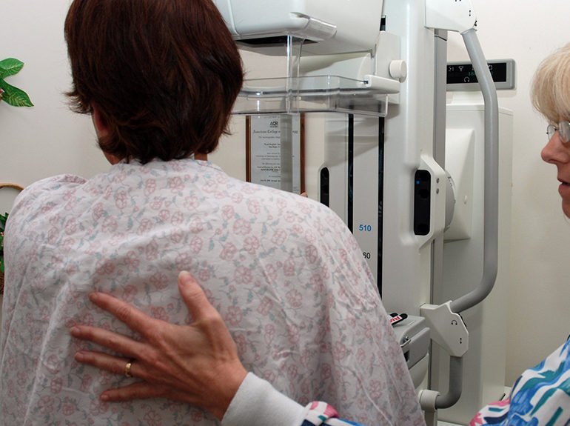
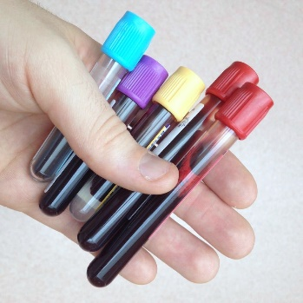
Adult health
2017-2018 Statistical Report
BCCCP & Wise Woman
 | ADULT HEALTH
 | BCCCP/PAP & BREAST
 | PSA
 | 2017-2018
14 | Federal BCCCP Patients
2 | Federal BCCCP Visits
33 | State BCCCP Patients
2 | State BCCCP Visits
40 | Pap & Breast Patients
0 | Pap & Breast Visits
6 | Medicaid Patients
0 | Medicaid Visits
1 | Medicare Patients
0 | Medicare Visits
29 | Wise Woman Participants
3 | Family Planning Pts served w/State funds
PSA
88 | Total Screened
46 | Black w/Normal Results
2 | Black w/Abnormal Results
40 | White w/Normal Results
0 | White w/Abnormal Results
1 | Diagnosed w/Prostate Cancer
1 | First Time PSA Screenings

Slide 13
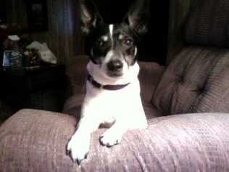
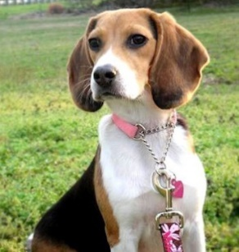
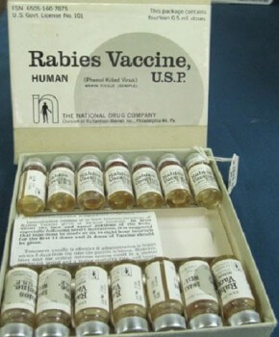
Animal Control
2017-2018 Statistical Report
2017-2018 Numbers:
 | 2017-2018
175 | Dogs Impounded
165 | Cats Impounded
75 | Dogs euthanized by NCHD
151 | Cats euthanized by NCHD
104 | Dogs adopted out
14 | Cats adopted out
3 | Vaccination Clinics Held
1,001 | Dogs/Cats vaccinated at clinics
22 | Animal Bites Reported
6 | Animal Heads sent to Raleigh for evaluation
2 | People vaccinated for Rabies exposure
18 | Dogs reclaimed
1 | Cats reclaimed
49 | Vouchers issued
 | Place Dogs | Cats | Total
 | NCHS-E (Old) 224 | 22 | 246
 | Cultural/Wellness 345 | 29 | 374
 | Gaston 343 | 38 | 381
Pet Adoption Program

Slide 14
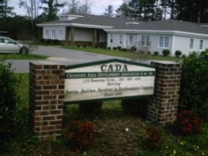
EAT SMART COOK
Child Health
2017-2018 Statistical Report
 | CHILD HEALTH
 | 2017-2018
140 | Total Patients
0 | Newborn Assessments
123 | Insured
22 | Uninsured
4 | Blue Cross
116 | Medicaid
4 | Blue Cross/Blue Shield
2 | Patient Pay
3 | SFS Adjustment
Head start
75 Early Head Start children served
Performed hearing and vision screenings for all children enrolled once yearly. Performed review of children’s health record to assess physicals, immunizations & health care plans. Tracked Well Child checks and immunizations and notified parents when due.
1 Pregnant woman served
-Provided 1st Trimester education, 3rd Trimester education and postpartum education in the home setting.
Served on HeadStart/Early HeadStart Advisory Committee: 2 meetings per year.

Slide 15
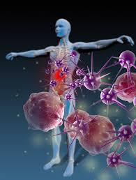
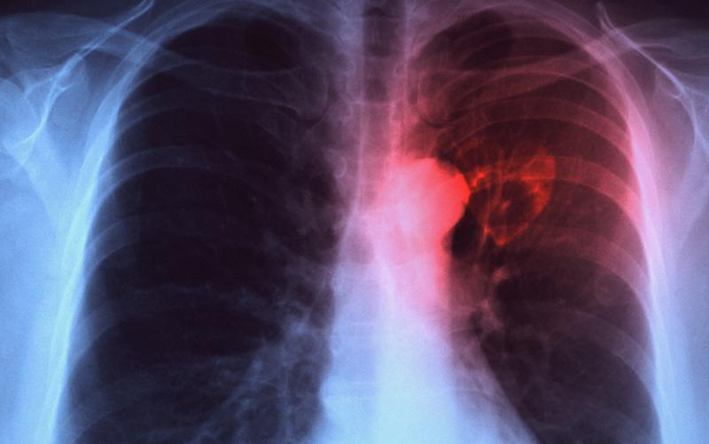
2017-2018 Statistical Report
Communicable Disease
HIV/AIDS
New HIV cases 0
Tuberculosis
TB cases on drugs 0
Contacts on drugs 0
Reactors on drugs 6
Patients with TB & HIV 0
Sputum tests for TB 0
Total TB skin tests given per Health Dept. 97
Positive TB skin tests 6
New reported TB case 0
Suspected case of TB 1
Office visits (Directly Observed Therapy) 32
Communicable Disease Reports (other than STD)
Acute Hepatitis B 0
Hepatitis B Carrier 0
Lyme’s Disease 1
Probable Rocky Mountain Spotted Fever 3
Salmonella 0

Slide 16
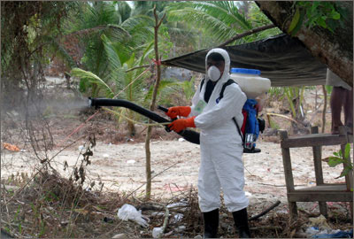
Water & Sewage
ENVIRONMENTAL HEALTH
2017-2018 Statistical Report
Food & Lodging
 | WATER and SEWAGE
641 | Site Visits
0 | New Improvement Permits Issued w/Plat
45 | New Improvement Permits Issued w/Site Plan
 | Improvement Permits Issued for Expansion of
12 | Existing System
3 | Documented Improvement Permits Denied
41 | Construction Authorizations
26 | Construction Authorizations for Expansions;
15 | for Repair;
0 | Denied
3 | Authorizations for Mobile Home Parks
14 | Authorizations for Existing System Re-use/Relocation
35 | New Operation Permits:
10 | Expansion Operation Permits
14 | Repair Operation Permits
Inspections 174
Visits 41
Consultative contacts (phone/office) 79 Permits Issued 3
Transitional Permits Issued 1
Pre-opening and/or construction visits 5
Solid and Hazardous Waste
4 Consecutive Contacts by Phone/Office/Other
5 Complaint Investigations
Well & Water Samples
Well Site Visits 21
Grouting Inspection 1 New Water Supply Approved 1 Bacteriological Samples Collected 61 Other Samples Collected 17 Water Supply Permits Issued 2 Consultative Contacts by Phone/Office/Other 90 Complaint Investigations 0
General Sanitation
Complaint Investigations 0
Premise Visits for other reasons 51 Swimming Pool Inspections 6 Lead Investigations 0 Consultative Contacts by Phone/Office/Other 31
Vector Control
Other Vector Control Activities 0 Consultative Contacts by Phone/Office/Other 0
Complaint Investigations 0

Slide 17
Family planning
2017-2018 Statistical Report
 | FAMILY PLANNING
 | 2017-2018
169 | Unduplicated Patients (168 female/1 male)
27 | Teens (19 and under)
28 | Depo-Provera Clients
17 | Contraceptive Pill Clients
 | IUD
 | No Method-seeking pregnancy
12 | Condoms
Payer Sources
101 | Medicaid
3 | Medicare
49 | Self Pay
30 | Private Ins.
 | Commerical
50 | Percentage Income Below 250% FPL
5% of Family Planning patients are non-English speaking

Slide 18
2017-2018 Statistical Report
Home health
Northampton County Home Health Agency has provided home care services to patients in Northampton County since 1976.
The Agency is owned and operated by Northampton County Local Government and housed in the Northampton County Health Department.
Home Health services through Northampton County Home Health Agency are available to those who:
Live in Northampton County or the surrounding area
Are in need of home health services
Are under the care of a doctor
Home Health Care is provided by a highly trained staff working directly under the written orders of a physician. Services are provided in the comfort of the patient’s home. Services may include:
Skilled Care
Skilled Nursing
Physical Therapy
Speech Therapy
Occupational Therapy
Support Services - Home Health Aides
2017-2018 Numbers
Skilled Nursing Visits 2,447
Physical Therapy Visits 2,128
Occupational Therapy Visits 147 Speech Therapy Visits 110
Home Health Aide Visits 328
CAP/DA Patients Seen 62
Northampton County Health Department d/b/a Northampton County Home Health Agency 9495 NC 305 Highway Jackson, NC 27845 Accreditation Details Dates: 1/1/2014 through 1/1/2017
Program: Home Health (Deemed)
Services: Home Health Aide Services, Occupational Therapy Services, Physical Therapy Services, Skilled Nursing Services, Speech Therapy Services

Slide 19
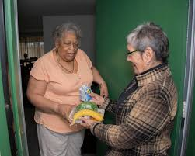
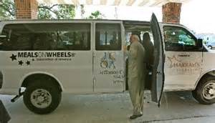
2017-2018 Statistical Report
Home Delivered Meals
Numbers:
People Served—Daily average of 34
Meals Delivered—8,187
Volunteers Utilized--65
Meal Sites--11
Delivery Sites:
Conway, Galatia, Garysburg, Gaston, Henrico, Jackson, Milwaukee, Rich Square, Seaboard, Severn, Woodland.
The Home Delivered Meals program has delivered nutritionally balanced meals to eligible citizens since 1994. This helps to maintain and improve the health of older persons in greatest economic and social need as these nutritionally balanced meals are served in the home. The program delivers to 11 meal sites utilizing volunteers to transport the meals from the meal site to recipients.
Meals are prepared and packaged by the Robert E. Sessoms Youth Center in Garysburg.

Slide 20
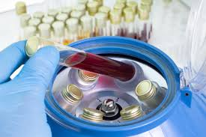
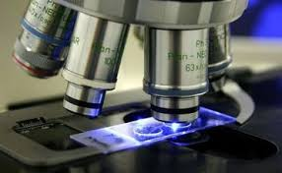
2017-2018 Statistical Report
Laboratory
Tests performed in-house 2,233 Controls/Proficiencies 1,045
Water samples - total 298
Public Water Supply 288
Private Water Supply 35
4-year average of 3,539 clients tested
4-year average of 2,308 in-house QC, PT and Water tests completed
4-year average of 3,207 sent out for testing
The Northampton County Health Department and Home Health Agency is certified by CLIA (Clinical Laboratory Improvement Amendments). This certificate allows us to perform moderately complex laboratory testing.
The Northampton County Health Department Laboratory is also certified by the North Carolina Department of Health and Human Services, State Laboratory of Public Health to perform Total Coliform and E. Coli Analyses on North Carolina water supplies.

Slide 21
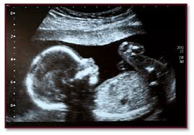
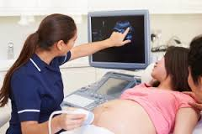
Services Provided: Prenatal care including guidance and health education for labor and deliver, child care, safety, and family planning. Physicals, in-house lab testing, and services for teens and adults. We have a Nutritionist on staff that is available for weight and diabetic prenatal needs. Home visits for clients with high risk pregnancy issues are available as well as assistance with transportation needs for those who qualify.
Maternal Health
2017-2018 Statistical Report
In order to give your baby a healthy start in life, it is vital to begin your prenatal care early in your pregnancy and continue this care throughout your entire pregnancy. Your baby's health is closely tied to yours. If you are pregnant, or considering getting pregnant, our maternity health services offers comprehensive prenatal care including services after you deliver.
Who is eligible?
Females of any age with a positive pregnancy test.
Numbers:
Receiving Clinic Services 51 (41 Medicaid and 10 Non-Medicaid Patients)
2 Teen Patients 5 age 35+ years
Clients Served by County
of Residence:
Northampton County 40
Hertford County 4 Bertie County 1
Halifax County 2
Unknown 4
2 | Hispanic Mexican American
8 | Hispanic
41 | Non Hispanic
 | Unreported
 | Race:
33 | Black or African American
0 | Unknown
17 | White
Postpartum Assessments -- none
38 Medicaid
7 Self Pay
3 Blue Cross
2 FP Waiver
1 MPW

Slide 22
2017-2018 Statistical Report
Nurse Family Partnership
Nurse-Family Partnership is a rare community health program that has been documented to
Characteristics Taken at Intake:
Serving the Counties of Edgecombe, Halifax, Hertford, Nash and Northampton
NFP Team | Median Age | Age <15 | 15-17 | 18-19 | 20-24 | 25-29 | >=30
Northeastern NFP Collaborative | 20 | 3.8% | 23.1% | 15.4% | 34.6% | 15.4% | 7.7%
NC Total | 21 | 1.6% | 17.4% | 18.6% | 43.3% | 12.1% | 6.9%
National Total | 21 | 1.6% | 16.6% | 19.6% | 36.1% | 15.8% | 10.3%
NFP Team | % HS Completion | % GED Completion | % Married
Northeastern NFP | 56.8% | 1.2% | 5.3%
NC Total | 56.1% | 3.7% | 10.4%
National Total | 58.1% | 4.6% | 16.1%
Attrition during Pregnancy:
Attrition is a concern nationally; it is an NSO requirement that each site complete an annual plan to address attrition and develop
a plan to decrease the percentage.
NFP Team | Attrition
Northeastern NFP | 11.9%
NC Total | 12.4%
National Total | 15.4%
*Another focus area nationally for NFP is the impact on Premature Birth. The table listed below offers baseline data and will be more relevant as more data is collected.
NFP Team | % Total | Total Births | %<15 | %15-17 | %18-19 | %20-24
Northeastern NFP | 6.6% | 152 | 33.3% | 13.0% | 3.4% | 6.5%
NC Total | 9.2% | 3,636 | 9.% | 8.6% | 9.3% | 8.7%
National Total | 9.6% | 157,913 | 11.4% | 9.2% | 8.8% | 9.2%

Slide 23
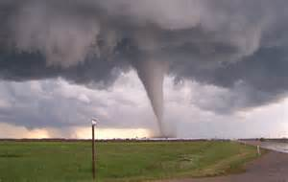
2017-2018 Statistical Report
Preparedness & response
PREPAREDNESS
2017-2018
July 2017-Conducted a hurricane tabletop exercise for Home Health
August 2017-Conducted Respiratory Fit testing for staff
August 2017-Conducted Annual Safety training including Bloodborne
pathogens
September 2017-Participated in Emergency Readiness tabletop exercise
for Northampton County with 83rd Civil Affairs Battalion, U.S. Army
October 2017-Gave out Preparedness information and incentives at a
booth for "Open House Gaston Volunteer Fire Dept.'s Safety Day"
October 2017-Participated in Regional (Northampton, Wilson, Halifax,
Edgecombe and Nash) tabletop exercise including meeting guidelines
for the Centers for Medicare and Medicaid Services (CMS)
January/February 2018-Collaborated with Northampton County Cooperative
Extension and Fit tested 98 farmers
March 2018-Gave out Preparedness information in water bottles during
the Woodland Easter parade
April 2018-Conducted and hosted Strategic National Stockpile: Law
Enforcement training with the US Marshal for Northampton, Wilson,
Halifax, Edgecombe and Nash counties.
May 2018-Participated in Regional Sheltering tabletop exercise
May 2018-Medical Countermeasure Material Operational Readiness Review
(MCM ORR) submitted (There was no grade tied to this year's submission)
June 2018- Participated in the North Carolina Public Health
Preparedness & Response (NCPHP&R) Central Region Pan Flu readiness tabletop exercise
Through our Public Health Preparedness & Response (PHP&R) program, the Northampton County Health Department's Preparedness Coordinator, along with local emergency management and first responders, aim to work with the community to keep Northampton County citizens prepared and safe during any disaster.

Slide 24
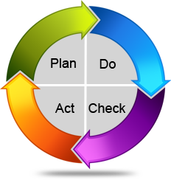
Quality Improvement
2017-2018 Statistical Report
QUALITY IMPROVEMENT
2017-2018
October 2017-Conducted client satisfaction surveys
January 2018-Re-Accreditation Site Visit
April 2018-Cultural Diversity training
April/May 2018-Conducted client satisfaction surveys
May 2018-Earned Re-accreditation with Honors status from the North Carolina Local Health
Department Accreditation Board

Slide 25
Numbers
WIC
2017-2018 Statistical Report
WIC is a Special Supplemental Nutrition Program funded by the United States Department of Agriculture. This program provides nutritional education to women (pregnant, postpartum and breastfeeding), infants and children to age 5. Through this federally funded program participants receive vouchers to exchange for food items at participating WIC vendors. For more information contact the Northampton County Health Department at 252-534-5841.
Who is eligible?
Pregnant, postpartum and breastfeeding women who meet the required criteria
Infants and children to age 5.
NOTE: Eligibility is determined based on income, medical nutrition risk and residence
6,558 Participants received vouchers
An average of 547 participants were served per month.

Slide 26
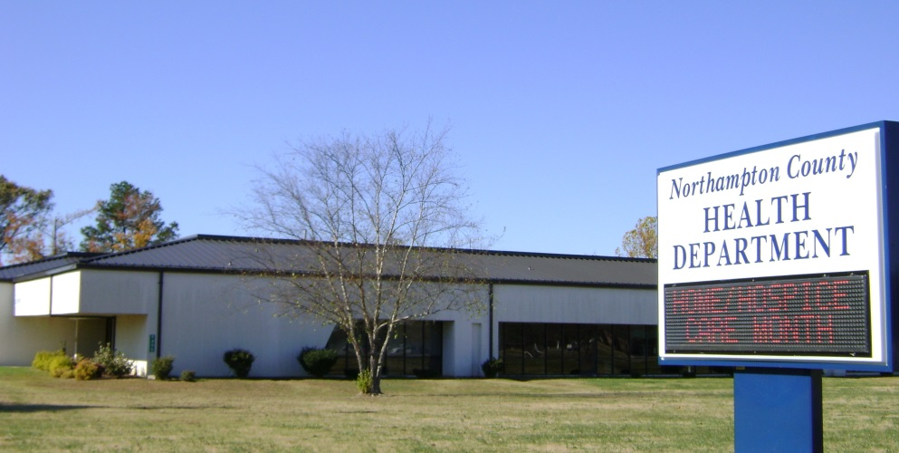
Contact Information
2017-2018 Statistical Report
Phone:
252-534-5841
(Health Department)
252-534-1291 (Home Health)
FAX:
252-534-1045
252-534-1207 (Administration)
252-534-1064 (Home Health)
Northampton County Health Department
9495 NC Hwy. 305
Post Office Box 635
Jackson, NC 27845
Visit our website for more information:
We are on Facebook!
www.northamptonhd.com

